Slide 1
WIPRO NGA Program- C++ LSP Batch
Capstone Project Presentation: 12 August 2024
Project title: real time chat application using client-server
Architecture
Presented by: Dnyaneshwari Badarkhe

Slide 2
Project Overview:
This project aims to provide the experience of building real-time interactive
applications while integrating the level of interaction through the Linux device
driver. The main goal is to create an interactive application that allows instant
communication between users through a web interface and includes a custom
Linux device driver to monitor and report assessment measures.

Slide 3
Introduction:
This project involves developing a Linux character device driver to retrieve
and output system metrics such as CPU usage, memory usage, and disk I/O
metrics. The device driver can be loaded and unloaded from the kernel and
provides a character device interface for user interaction.

Slide 4
Motivation:
The motivation behind this project is to develop a Linux character device
driver that provides real-time monitoring of system performance metrics. This
tool helps in proactive resource management by offering insights into CPU,
memory, and disk usage. Additionally, it serves as a valuable learning
experience in Linux kernel programming and practical system monitoring.

Slide 5
Project Scope:
Create a Linux character device driver to print system metrics.
Retrieve various system metrics such as CPU usage, memory usage, and disk I/O.
Output the retrieved metrics through a character device.

Slide 6
Various Application Tools Used:
Network Tool:
Gcc Compiler
Text Editor
System Monitoring Tool:
vmstat
Netstat
Htop
Debugging Tools:
gdb (GNU Debugger)
Lldb
Valgrind

Slide 7
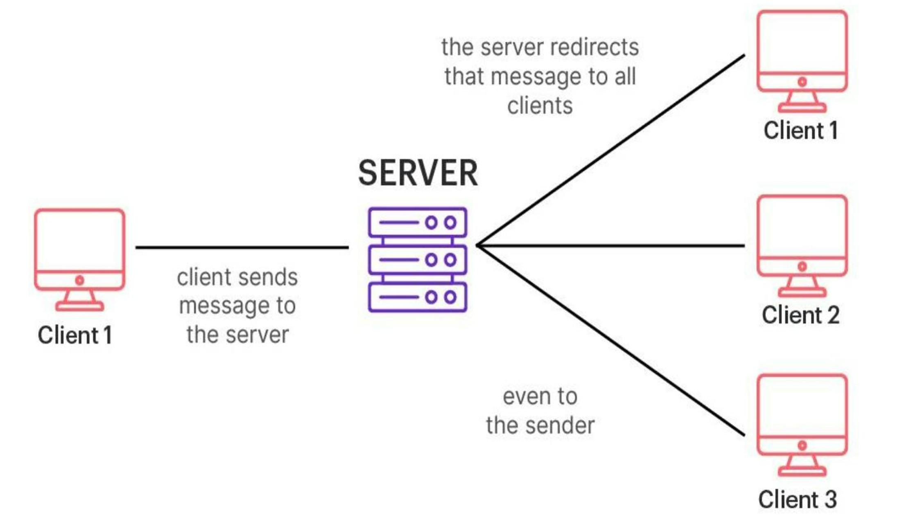
System Flow:

Slide 8
Modules:
Two Modules
1. Server Module
2. Client Module

Slide 9
Server Module:
Connection Management: Handles incoming client connections and maintains a list of active clients.
Message Handling: Processes and routes messages between clients or chat rooms.
Chat Room Management: Manages chat rooms, including creation, deletion, and membership.
Concurrency Handling: Uses multi-threading or asynchronous operations to handle
multiple clients simultaneously.
Error Handling: Manages and logs errors to ensure server stability.

Slide 10
Client Module:
Connection to Server: Establishes and maintains a connection with the server.
User Interface: Provides a way for users to send and receive messages and manage chat rooms.
Message Handling: Sends messages to the server and displays incoming messages.
Chat Room Management: Allows users to join, leave, and interact within chat rooms.
Error Handling: Manages errors, handles disconnections, and provides reconnection options.

Slide 11
List of Functions Used:
Server Module Functions:
1.socket(): Creates a new socket.
2.bind(): Binds the socket to a specific address and port.
3.listen(): Listens for incoming connections on the socket.
4.accept(): Accepts a new connection from a client.
5.pthread_create(): Creates a new thread for each client connection.
6.pthread_join(): Waits for threads to complete.
7.handle_client(): Function to handle communication with a single client.
8.recv(): Receives data from a socket.
9.send(): Sends data to a socket.
10. perror(): Prints an error message.
11. printf(): Outputs messages for logging.

Slide 12
Client Module Functions:
1. socket(): Creates a new socket.
2. connect(): Connects the socket to the server’s address.
3. getline(): Reads user input from the command line.
4. printf(): Outputs messages to the user.
5. close(): Closes the socket connection.
6. reconnect(): Attempts to reconnect if disconnected.

Slide 13
Future Enhancements:
Future enhancements for the real-time chat application will focus on enhancing security with authentication and encryption, scaling performance with load balancing and caching, and improving user experience with media support and notifications.
Advanced features will include message search, voice/video calls, and user management tools. The app will also expand with mobile support, localization, third-party integrations, and better accessibility based on user feedback.

Slide 14
Conclusion:
The real-time chat application effectively integrates core functionalities to deliver a responsive communication tool. Implemented in C++, the application benefits from efficient memory management and performance optimization, making it ideal for real-time interactions. Future improvements will include adding features like encryption, authentication, and a graphical user interface to further enhance both functionality and user experience.

